Slide 1

Business Analyst Career Program - Capstone Project
- By Vaibhav Kamboj

Slide 2
Agenda
Data Exploration
Statistical Analysis using Excel
Graphical Analysis using Excel
Insert the given data into the SQL server
Import the Data from the SQL Database into Power BI
Interactive Dashboard by using visualization tools
Conclusion and Inferences
Endnotes

Slide 3
Data Exploration

Slide 4
Data Exploration

Slide 5
Data Summary
Country-wise Sales, COGS and Profit Analysis:
Canada: Sales and COGS are balanced (both around 20.96%).
Profit is (around 20.9%), suggesting that cost control could be improved.
France: Sales (20.51%) and COGS (20.20%) are fairly aligned, though COGS is slightly lower.
Highest Profit (22.4%) showing efficient cost management.
Germany: Sales and COGS are balanced (around 19.8% and 19.5%).
Profit is higher (21.8%), reflecting good efficiency.
Mexico: Sales and COGS are nearly the same (around 17.7%).
Lowest Profit (17.2%).
USA: Sales (21.1%) and COGS (21.6%) are closely matched.
Profit is much lower (17.7%), suggesting high costs reduce earnings.

Slide 6
Data Summary
Segment-wise sales, profit, and Discount Analysis:
Channel Partners: Low sales (1.52%), good profit (7.79%), minimal discount (1.46%).
Enterprise: High sales (16.52%), negative profit (-3.64%), large discount (15.83%).
Government: Highest sales (44.22%), profit (67.41%), and units sold (41.81%), heavy discount (42.35%).
Midmarket: Small sales (2.01%), moderate profit (3.91%), low discount (2.18%).
Small Business: Strong sales (35.74%), good profit (24.52%), high discount (38.17%).
The Government and Small Business segments are the main revenue and profit drivers.

Slide 7
Data Summary
Product-wise Performance:
• Best-performing by Sales:
Paseo: Highest sales (27.80%) and profit (28.40%) and units sold (30.04%) with a significant discount (28.25%).
• Worst-performing by Sales:
Carretera: Lowest sales (11.64%) and profit (10.81%) with moderate units sold (13.04%) and discount (12.19%).

Slide 8
Data Summary
Time-based Trends Analysis:
2013 Performance:
Sales (22.25%), with a slightly higher profit share (22.96%) and units sold at 23.51%.
Indicates that 2013 had a stable performance, with sales, profit, and units sold closely aligned.
2014 Performance:
Significant growth in 2014, contributing to 77.75% of total sales, 77.04% of profit, and 76.49% of units sold.
This indicates that 2014 was a highly successful year, driving the majority of the business's performance.

Slide 9
Statistical Analysis using Excel
Descriptive Analysis:
Correlation Analysis:

Slide 10
Graphical Analysis Using Excel

Slide 11
Graphical Analysis Using Excel

Slide 12
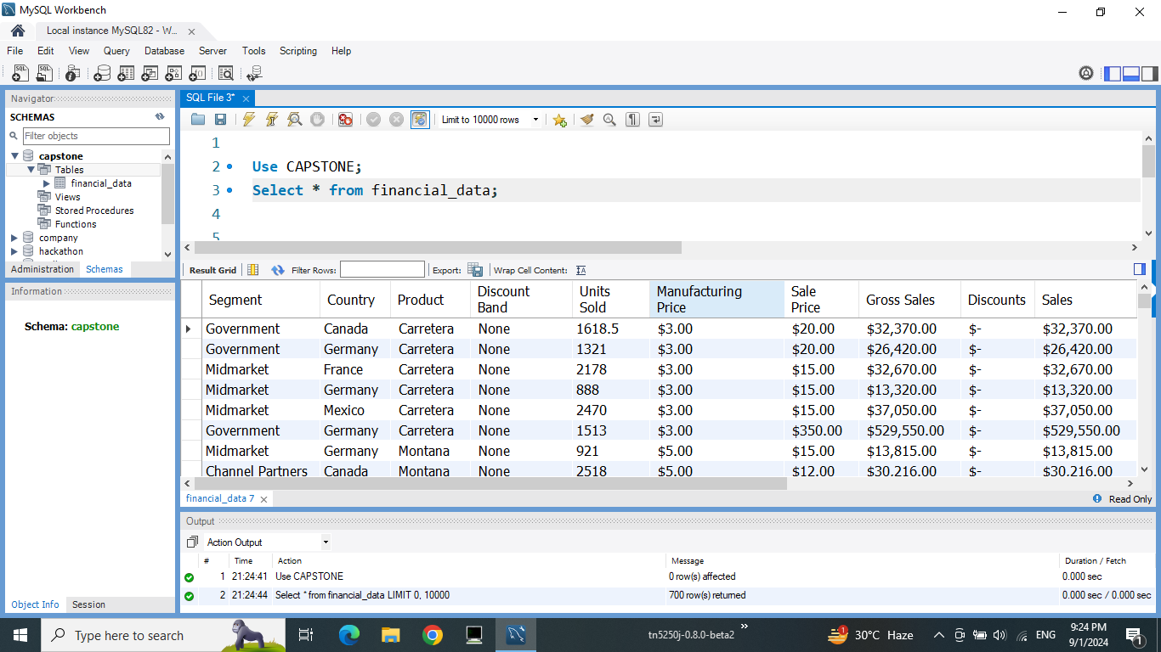
Insert the given data into the SQL server

Slide 13
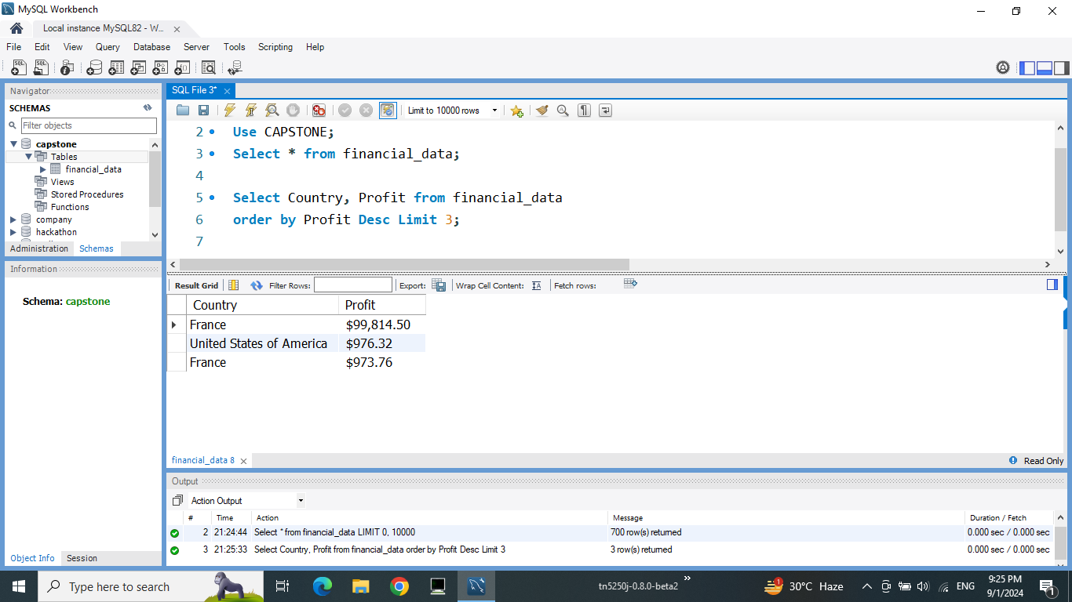
Insert the given data into the SQL server

Slide 14
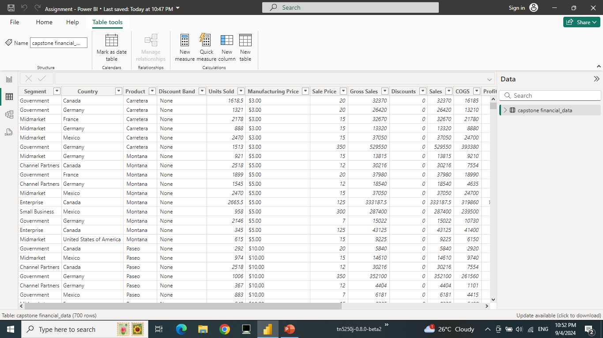
Import the Data from the SQL Database into Power BI

Slide 15
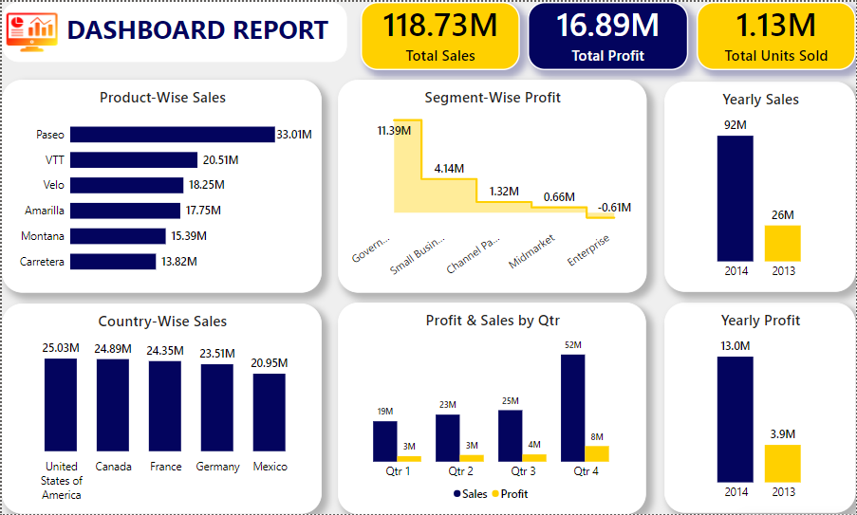
Interactive Dashboard

Slide 16
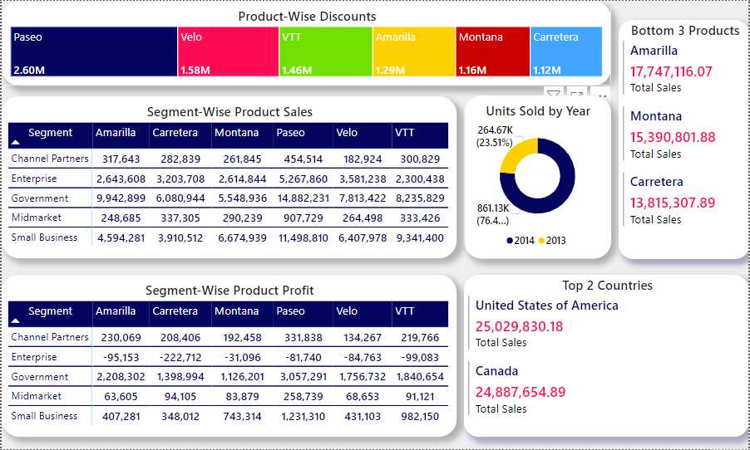
Interactive Dashboard

Slide 17
Conclusion And inferences
Product Performance:
Paseo is the top selling and the most discounted product.
VTT and Montana are also the top-performing products, driving substantial revenue but lower discounts.
Profitability by Segment:
Government segment's high profitability indicates strong demand and effective sales strategies.
The negative profit in the Enterprise segment suggests inefficiencies or high costs.
Geographic Sales Distribution:
USA and Canada are key markets, showing significant contributions to overall sales.
Countries with lower sales may require targeted marketing and sales strategies to improve performance.
Annual Growth:
The marked increase in profits and units sold from 2013 to 2014 highlights effective business strategies and market growth during this period.

Slide 18
Conclusion And inferences
Impact of Discounts:
Discount Band performance: By comparing sales and profit across different discount levels, you can gauge the effectiveness of discounting strategies.
A high discount might increase sales but decrease profit margins. Conversely, products sold without discounts might contribute more to the overall profit margin.
General Insights:
Profit Margins:
Products with higher sale prices but controlled costs will offer better margins. Identifying which countries or segments favor higher-margin products could help tailor sales strategies.
Market Focus:
Countries or segments that generate the most profit (even with lower sales) should be prioritized for future growth strategies.
By breaking down the analysis into these categories, you can draw valuable conclusions to guide decisions related to sales, marketing, pricing, and resource allocation.

Slide 19
End Notes
Excel File:
Power BI:

